Slide 1
Sound Localization: Feature Extraction and Machine Learning Approach
CS 582 Semester Project
May 2024

Slide 2
Road Map
Investigate sound localization techniques by integrating classical with machine learning algorithms
Problem: How do we localize azimuthal location of a sound source relative to our position?
Classical Methods: cross-correlation, ITD, ILD, spectral versions, MFCC
Machine learning methods: random forests
Objective: Localize azimuth of a sound source from binaural microphone recording
Extract relevant features from dataset and train a model to label sound with azimuth
After feature extraction, very high accuracy on localizing
Model should be tested on more realistic datasets

Slide 3
Localizing Sound
How do we localize sound from binaural sound data?
Form of data - .wav file
Two audio files, one for each ear
Raw files unhelpful for localization
Extract useful features
Train statistical model on labelled extracted features

Slide 4
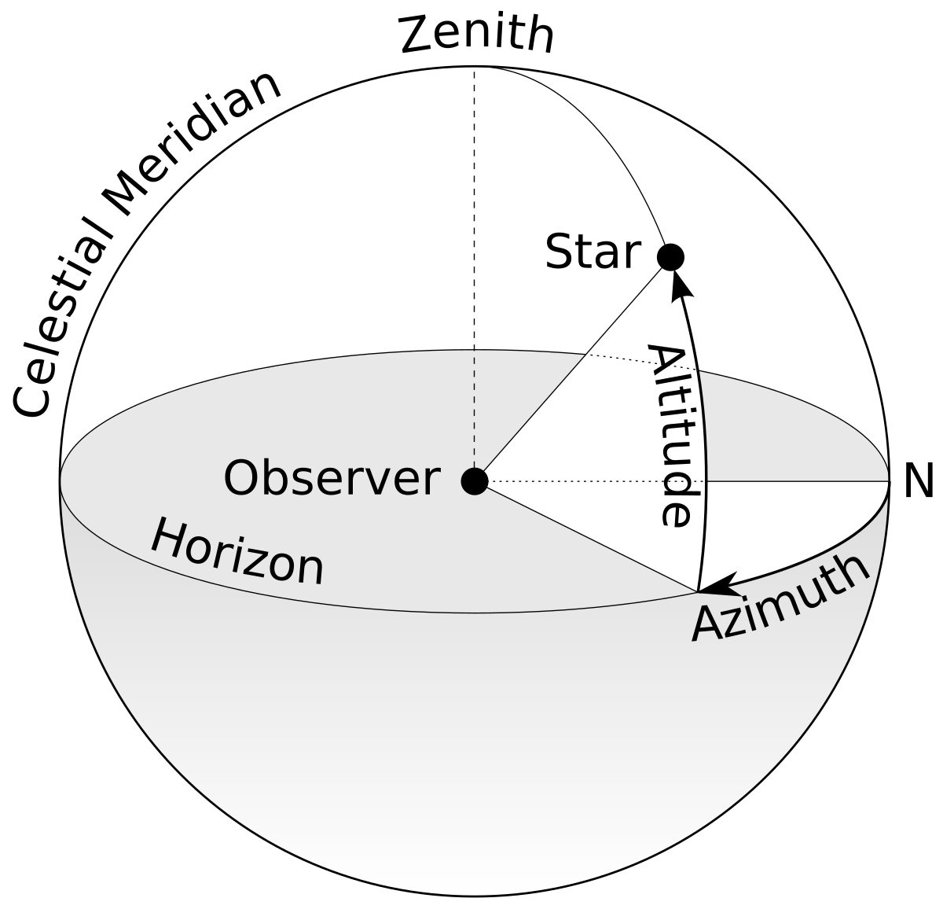
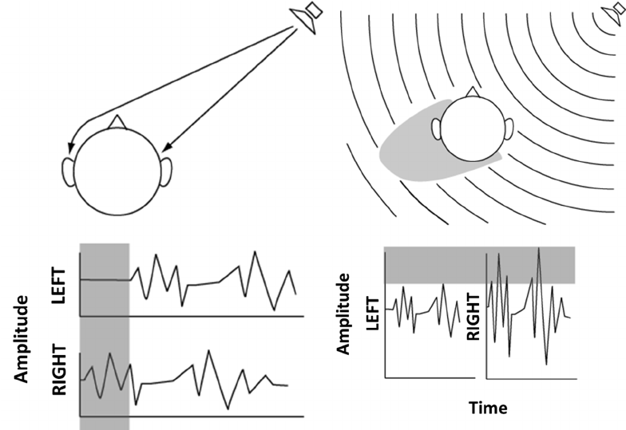
Concepts
Azimuth includes the polar coordinates (no depth)
Features extracted
Interaural Time Difference - diff in arrival time
Interaural level difference - diff in intensity
Spectral ITD, ILD - frequency-dependent variations in the time and intensity differences
Mel-frequency cepstral coefficients - representing the short-term power spectrum of the sound on a mel scale
Analogy: Imagine you're trying to describe the flavor of different foods to someone
Don’t list every ingredient
List categories like sweet, salty, or sour

Slide 5
Objective
Test setup:
feed various .wav files to feature extraction
Split training data into training, tuning, and testing
Train, tune, and test model
Label to be predicted is the azimuth (0-360 degrees)
Objective is to score highly on test metrics

Slide 6
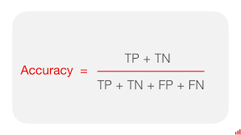
Results
Metric used was accuracy
Tuning score = 0.981
Test score = 0.990
Incredibly good performance

Slide 7
Methodology
Dataset: Gardner and Martin’s . ”HRTF Measurements of a KEMAR Dummy-Head Microphone”
14 Files grouped by elevation of sound source (elev-10 to elev90)
Each file has left and right .wav recording of the signal
Each left or right .wav has a azimuthal number (0-360 degrees)
Processing Data
Built functions for extracting ITD, ILD, Spectral ILD, Spectral ITD, and MFCC features
Processed Data was first grouped into their respective elevations then combined into a csv file
Final features: Elevation,Azimuth,ITD,ILD,Spectral ILD,Spectral ITD,Left MFCC,Right MFCC
Modeling: begin with random forest model to see what error we get on tuning data
Exceptionally good results meant we stop

Slide 8
Test results
Random sample of azimuthal location
from test set and our model’s predicted
azimuth on the features of that sound
Concentric circles are the number
Of data points with that azimuth

Slide 9
Conclusion
Dataset was highly controlled
Classical methods perform exceptionally well on binaural recordings
Form and dimensionality of features (e.g. MFCC) make it difficult to train models
Need deep understanding of the feature transformation to make use of them

